Slide 1
The metabolic and disturbance regime of North Florida Streams

Slide 2
Introduction:
Stream metabolism is governed by a suite of well-established drivers, with light serving as the primary control.
Disturbances such as floods can simultaneously alter multiple drivers, making them acute factor of lotic metabolism.
North Florida springs rank among the most productive and hydrologically stable flowing waters globally.However, these systems are increasingly experiencing disturbances that are shifting them from SAV-dominated states to filamentous algal dominance.
Many North Florida spring runs discharge into downstream tannic, blackwater rivers. During prolonged or intense precipitation events, rising river stages can generate backwater flood conditions.
Both typical floods and spring backwater floods drive shifts in the energetic and metabolic dynamics of flowing waters, with flow velocity representing a key distinction. In both scenarios, OM availability and light attenuation increase; however, typical floods are characterized by accelerated flow and elevated shear stress, whereas backwater floods involve reduced, stalled, or even reversed flow.
Objective: Improve understanding of the drivers governing spring metabolic regimes by examining metabolic responses (GPP and ER in addition to metabolic gas signals (DO and CO2) to backwater floods (brown outs and flow reversals).

Slide 3
Hypotheses
The spring metabolic signal will exhibit two breakpoints with depth: spring productivity will moderately decline with increasing stage and undergo a severe dropout at depths that trigger backwater flooding.
Less-disturbed spring runs will have greater tolerance for flood events, experiencing less severe metabolic impacts (shorter duration, smaller magnitude of change, resistance to change, and linear recovery trajectories) as well as faster recovery times compared to more frequently flooded spring runs.
Backwater floods produce lasting metabolic effects, with greater hysteresis observed in more disturbed spring runs.

Slide 4
Methods:
Six first-magnitude spring runs (IU, ID, GB, LF, AM, OS) representing a flood-vulnerability gradient; DO, CO2, pH, SpC, and stage monitored hourly 2022-2024
Stream metabolism (GPP, ER) estimated via two-station open-channel O2 method; NEP = GPP + ER
Step 1 Flood isolation: events identified from 3-day rolling slope of depth (|slope| > 0.01 d-1)
Step 2 Flood classification: each event assigned HI, BO, or FR from peak-window SpC and DO thresholds
Step 3 Impact window: each variable (depth, DO, CO2, GPP, ER) trimmed independently to its biologically active flood period
Step 4 Metric extraction: rise slope, peak magnitude (% change from baseline), duration, and recession slope per event per variable
Stage-metabolism breakpoints modeled via segmented (piecewise) linear regression; best model selected by adjusted R2

Slide 5
Stream Metabolism Estimation
Two-station open-channel O2 mass balance (AM, LF, GB, ID): paired upstream vent station and downstream sensor; not applicable to OS or IU
DO flux change = (DO_downstream - DO_vent) x Q / reach area; reaeration (K600 x depth x mean DO deficit from saturation) subtracted; remaining signal partitioned by day (GPP) and night (ER)
Active reach filter: observations excluded where estimated reach length < 0.4x or > 3x the physical channel; days with < 20 valid hourly observations removed
One-station Bayesian state-space model (streamMetabolizer; OS, IU): applied where no upstream vent exists; also fills high-discharge periods at two-station sites when depth exceeds the two-station calibration range
Quality filter: GPP > 0, ER < 0; Rhat 0.9-1.2 for both ER and K600; two-station estimates prioritized in the combined dataset

Slide 6
Reaeration Coefficient (K600)
K600 estimated from gas dome experiments conducted across a range of discharge conditions; a rating curve linked K600 to water depth
Two-station model uses a static, site-fixed K600: a single value per site derived from the mean of gas dome measurements
Why static K600 for the two-station model?
Better convergence with one-station Bayesian estimates - variable K600 degraded agreement between methods
More realistic GPP and ER values - static K600 produced estimates consistent with published spring metabolism literature
Consistent with previous spring metabolism studies (Cohen et al. 2013; Kirk et al.)
One-station model: K600 as near-fixed normal prior (OS, IU) or binned across ln(Q) nodes (AM, LF, GB, ID); all priors centered on gas dome measurements

Slide 7
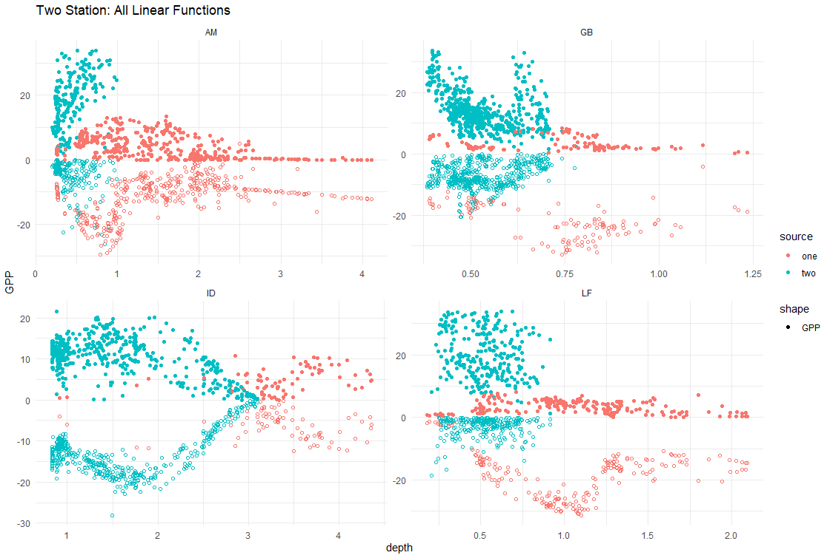
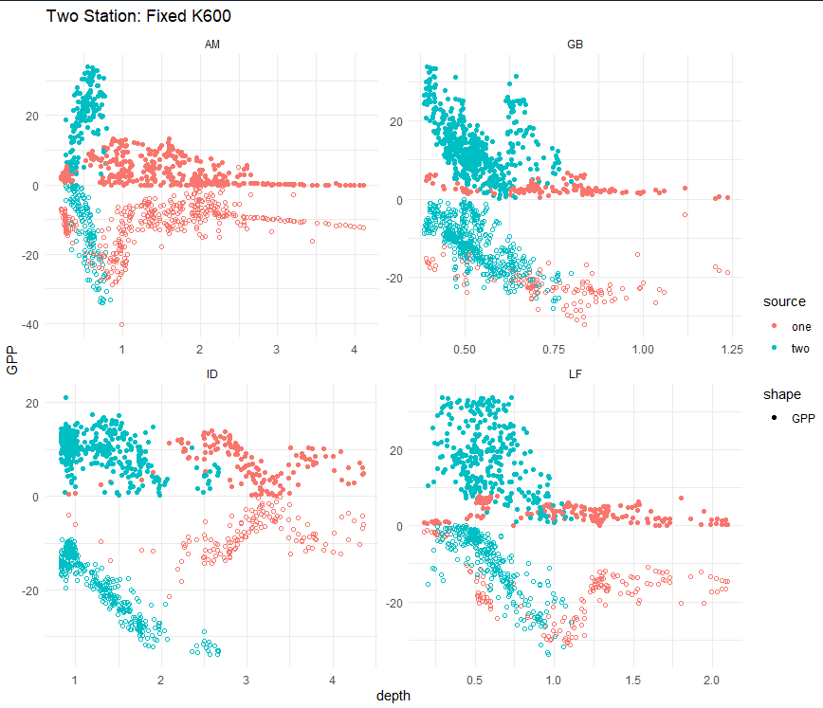
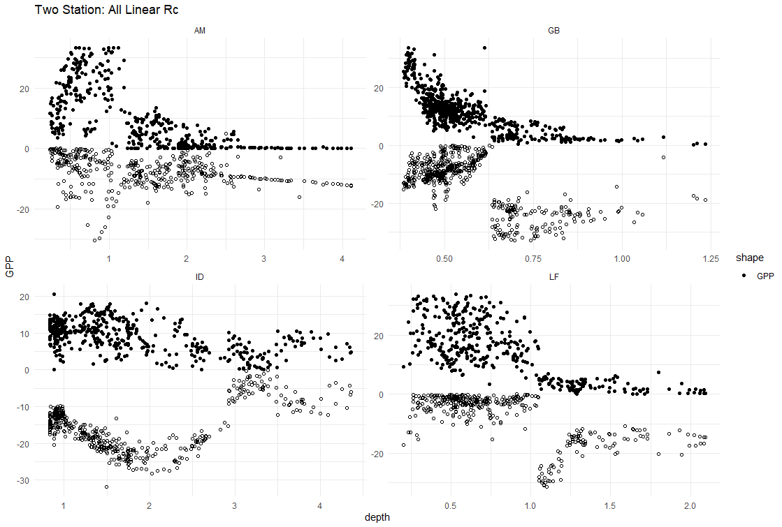
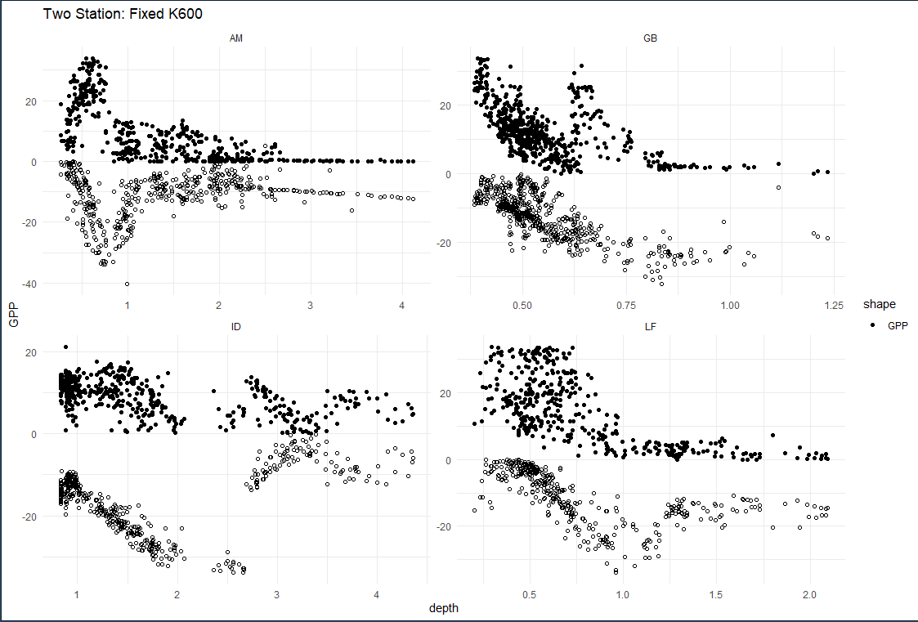
Messing with K once again…
“Gas‑dome experiments were conducted across a range of discharge states to obtain K₆₀₀ estimates. For the Spring site, K₆₀₀ values were interpolated from a well‑established rating curve that links water‑depth to the gas‑dome‑derived K₆₀₀. All other sites were assigned a single, fixed K₆₀₀ equal to the mean of the gas‑dome measurements, following approaches used in previous spring‑metabolism studies (Cohen et al. 2013; 2010; Kirk et al.). A sensitivity analysis indicated that using this fixed K₆₀₀ produced the most plausible metabolism estimates while retaining the dataset (instead of discarding observations).”

Slide 8
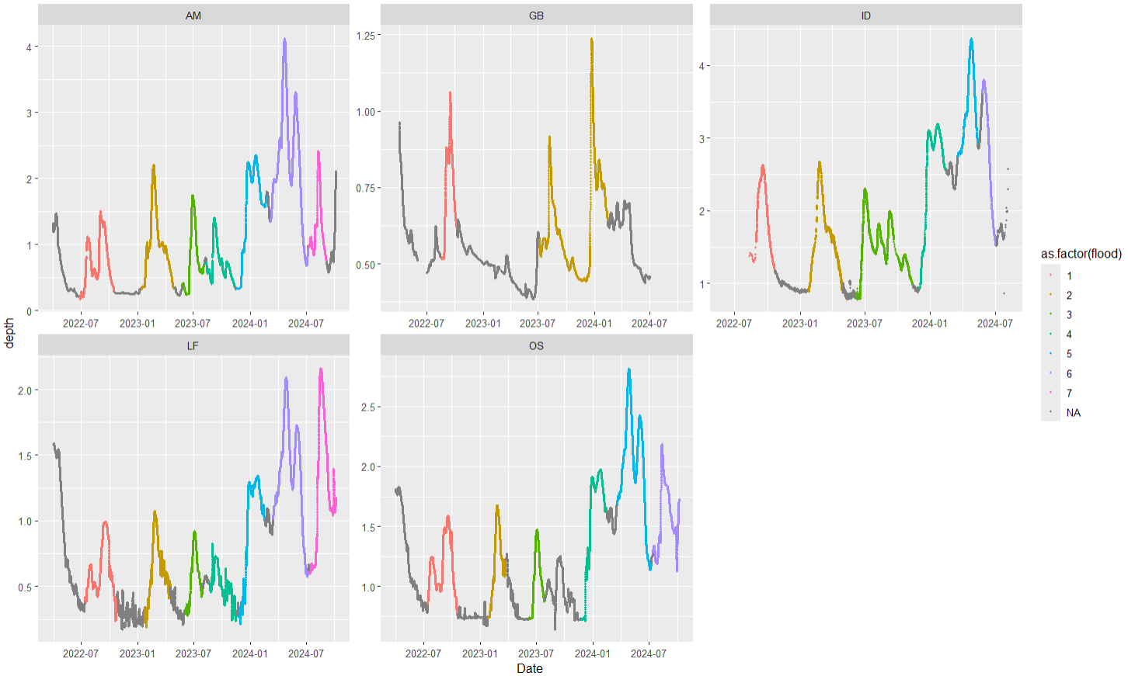
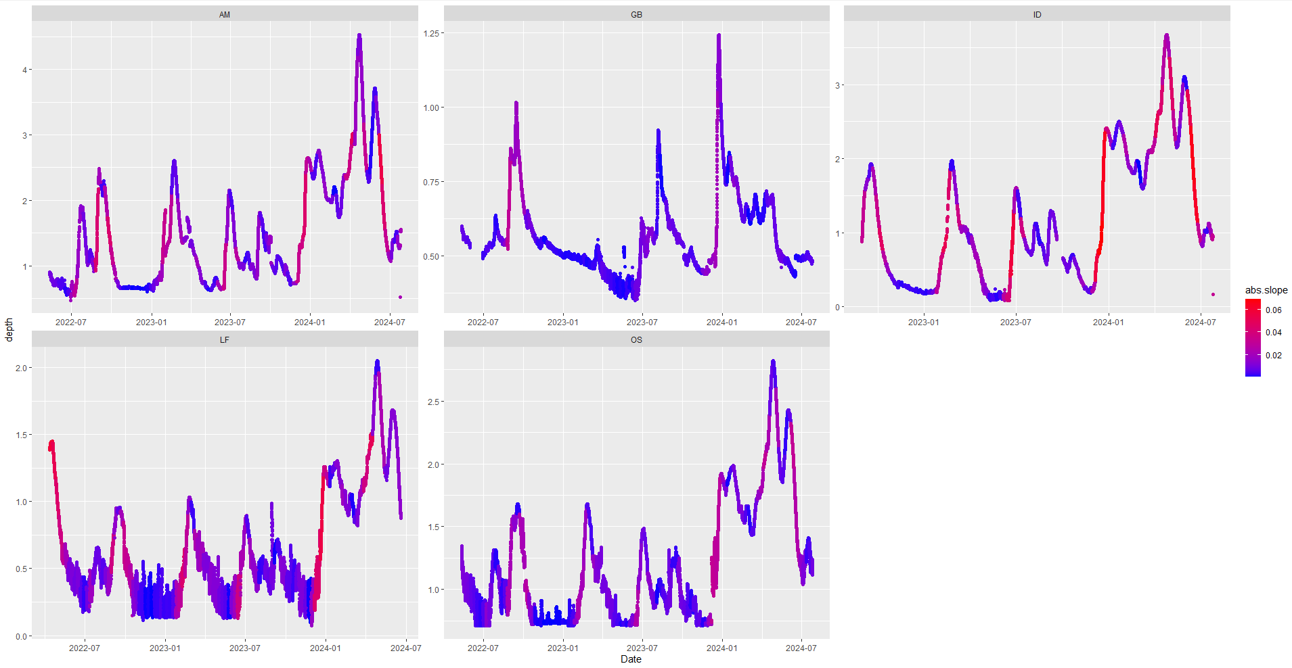
Step 1: Flood Event Isolation
Flood isolation procedure:
• Depth smoothed via LOESS (span = 0.1); normalized to site mean depth
• 3-day rolling blocks: slope of normalized depth estimated by linear regression
• Periods with |slope| > 0.01 d-1 flagged as active stage change
• Flood event = positive-slope run immediately followed by negative-slope run
• Stage-metabolism breakpoints: segmented linear regression; best model (1 vs. 2 breakpoints) selected by adj. R2 gain >= 0.02

Slide 9
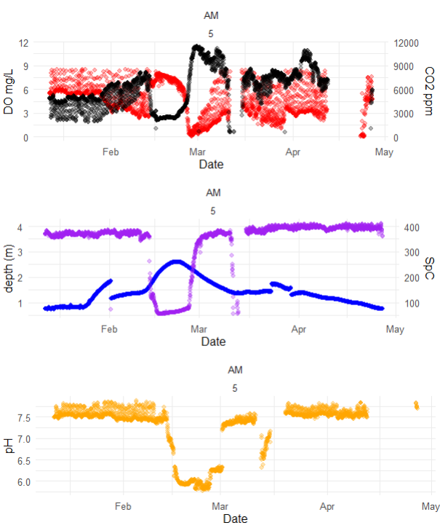
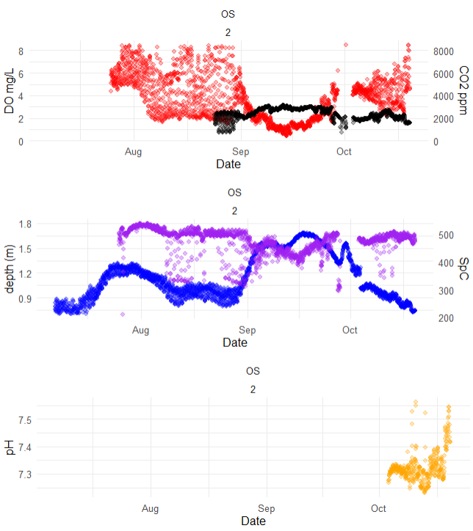
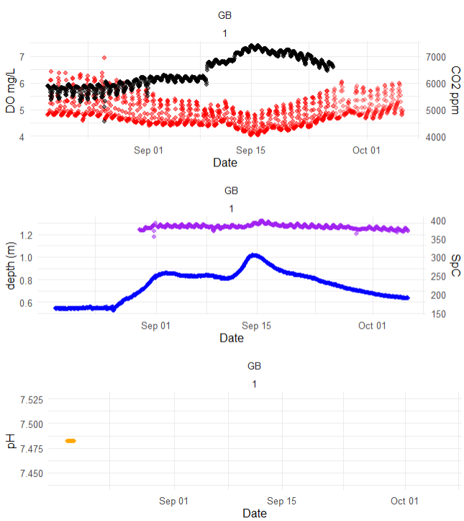
Step 2: Flood Classification (HI / BO / FR)
Flow Reversal
Brown Out
High Stage
FR (Flow Reversal): SpC < 200 uS/cm - river water overtakes spring run | BO (Brown Out): DO < 3 mg/L - hypoxia from light occlusion + riverine DOC | HI (High Stage): neither criterion - spring water retained. Priority: FR > BO > HI

Slide 10
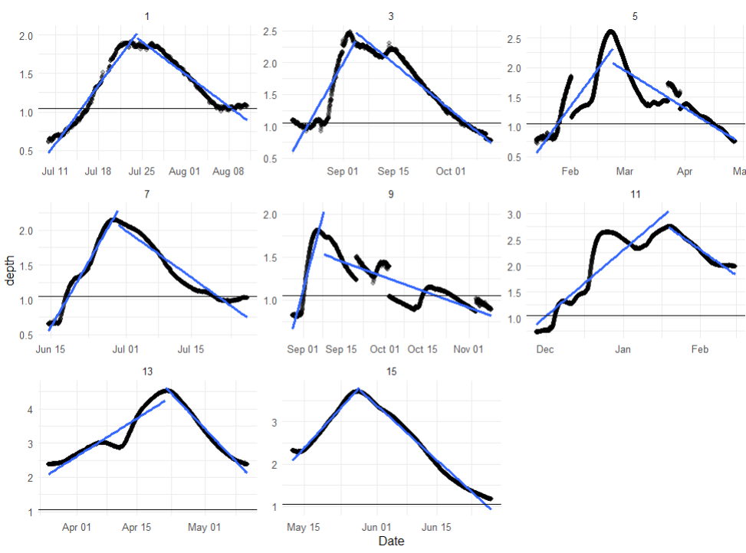
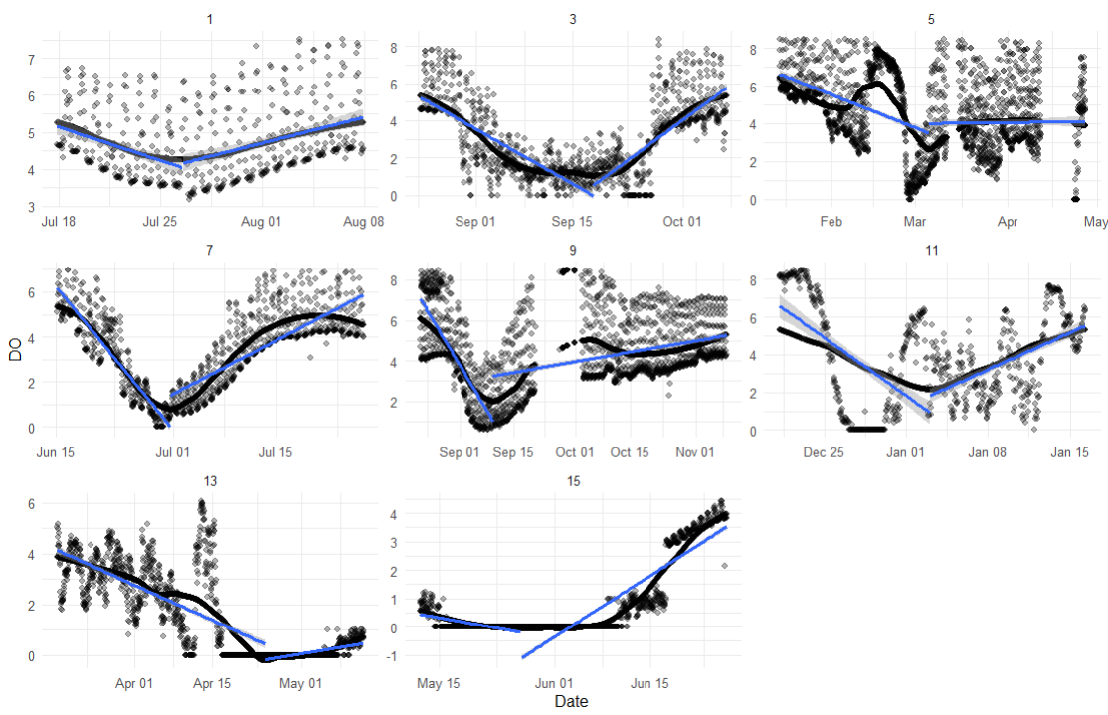
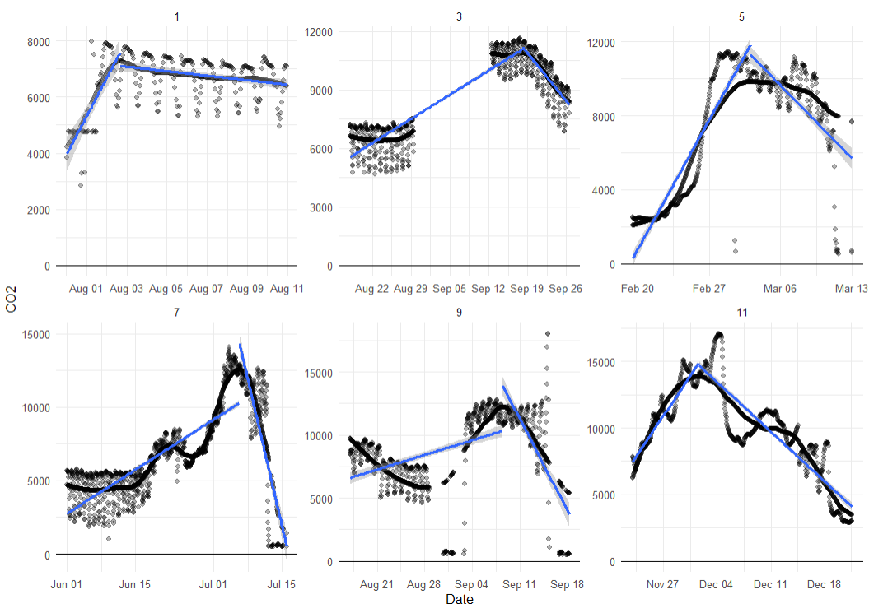
Step 4: Disturbance Metrics
Just length of days but I can pull date range if necessary
duration
Slope, intercept, solve for days
rise
rise
Date, number
peak
Each variable trimmed to its biologically active window independently. Peak identified as the 3-day rolling mean minimum (DO, GPP) or maximum (ER, CO2, depth). Flood start = first 3 consecutive days where variable crosses a +/-20% baseline threshold (or +/-0% if response < 20%). Flood end = first 3 consecutive post-peak day returning to that threshold. Baseline = mean of inter-flood observations nearest each event + observations at the site 25th-percentile depth.
Rise slope and R2: linear regression of daily values vs. days before peak (flood start to peak impact)
Peak magnitude: rolling mean min or max; expressed as % change from pre-flood baseline
Duration: days the variable remains beyond the +/-20% baseline threshold
Recession slope and R2: linear regression of daily values vs. days after peak (peak to flood end)
Notes:
Plot proportional decline
Before the flood, there was a mean and a variance
As soon as Im with sd of an index value…. Stop the regression--- IQR

Slide 11
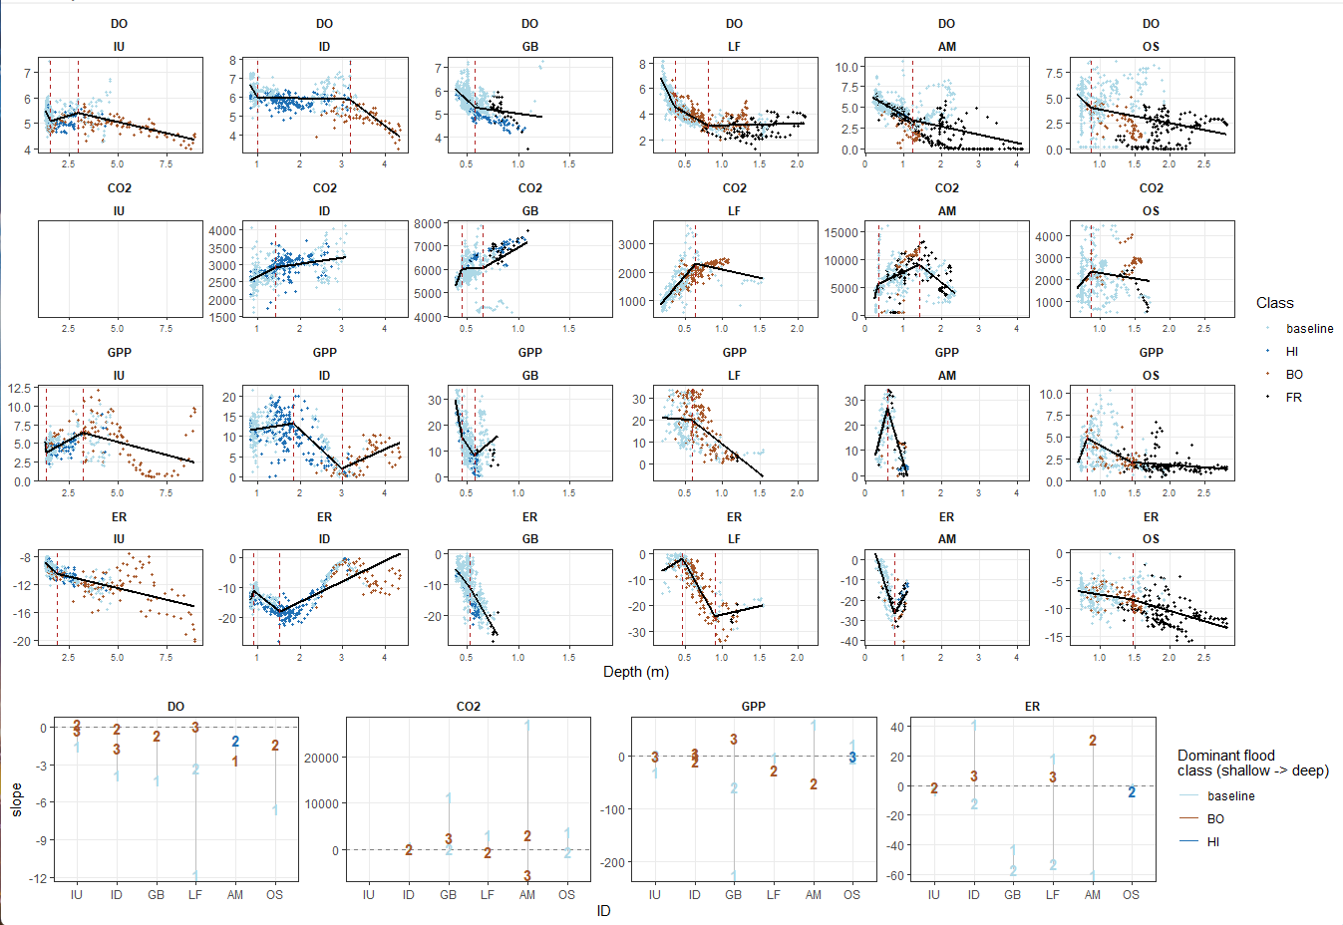
Results: The spring metabolic signal will exhibit two breakpoints with depth: spring productivity will moderately decline with increasing stage and undergo a severe dropout at depths that trigger backwater flooding.

Slide 12
Results: The spring metabolic signal will exhibit two breakpoints with depth: spring productivity will moderately decline with increasing stage and undergo a severe dropout at depths that trigger backwater flooding.
1
1: increased light attenuation
1
Hypothesis 1
2: Mixing of higher-DO river water slows decline
2: Light occluded and DO is limited
More vulnerable:
DO
GPP
2
2
1: increased light attenuation
1: Flood plain interaction spurs productivity
DO/GPP/NEP
1: increased light attenuation
2: Productivity unstable with increasing depth
2: Light occluded and DO is limited
2
Less vulnerable:
3
3: River nutrients spur productivity???
DO
2: Flood plain interaction spurs productivity
GPP
2
1
1
3
Actual
3: Productivity unstable with increasing depth/river water and crashes
3: No change in DO but change in depth= GPP inc?
Stage Percent Change
1: increased light attenuation
1: Flood plain interaction spurs productivity
2
2: River water with less CO2 replacing or mixing with spring water
2: increased light attenuation
More vulnerable:
1
CO2
1
2
2: River DOC spurring respiration
2: River nutrients spur productivity
ER
CO2/|ER|
2: DO limitation
2: River DOC spurring respiration
2: DO limitation
1: increased light attenuation
1: Flood plain interaction spurs productivity
1: increased light attenuation
Less vulnerable:
3
CO2
1
1
ER
2
2: increased light attenuation
2: River DOC spurring respiration
3: River nutrients spur productivity???
Stage Percent Change
3: No change in DO but change in depth= GPP inc?

Slide 13
Results: The spring metabolic signal will exhibit two breakpoints with depth: spring productivity will moderately decline with increasing stage and undergo a severe dropout at depths that trigger backwater flooding.
Results: ER and GPP respond complementary to backwater floods resulting in a distinct decline in NEP.
Hypothesis 1
1: increased light attenuation
1: increased light attenuation
DO/GPP/NEP
2: Light occluded and DO is limited
Actual
NEP
2: River DOC spurring respiration
3. DO limitation and springs reach a hypoxic state
Stage Percent Change
CO2/|ER|
1: increased light attenuation
Stage Percent Change
Bottom Line: There is a tight mechanistic cascade dependent on source water :
Stage ↑ → light attenuation ↑ → GPP → 0 → DO ↓ → CO₂ ↑ → ER ↑
Stage Percent Change

Slide 14
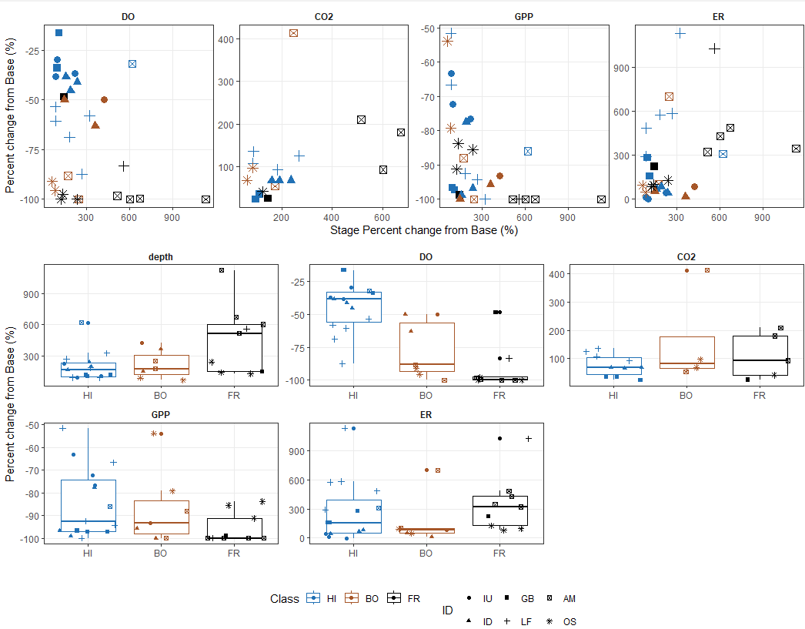
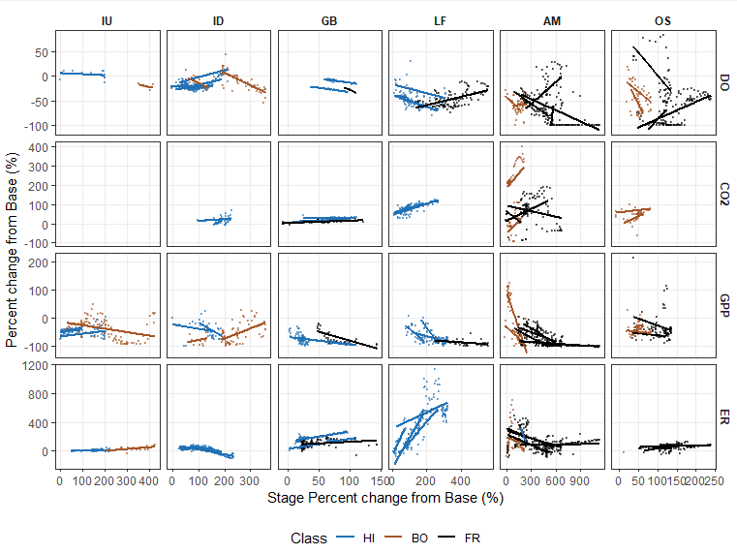
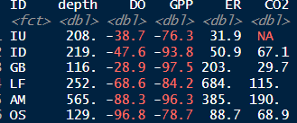
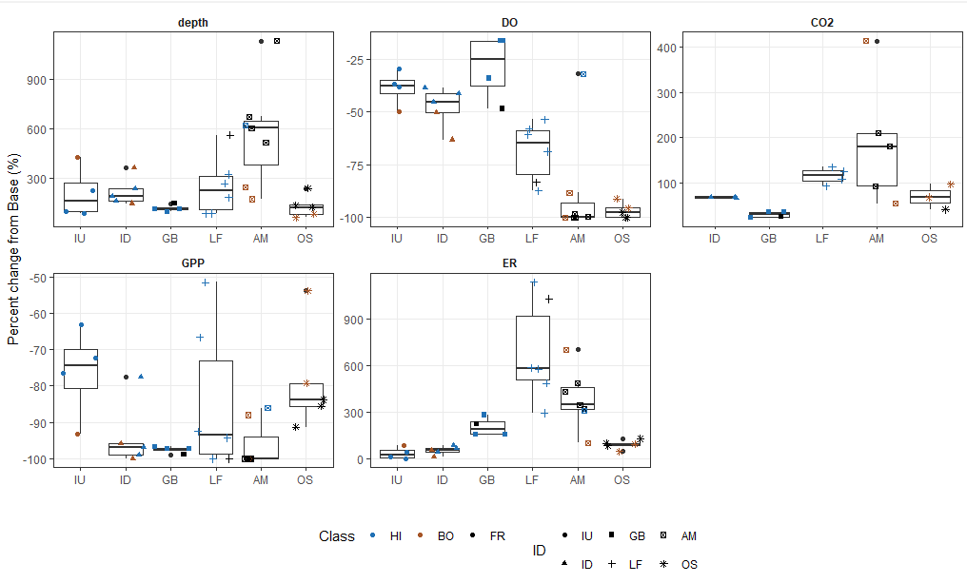
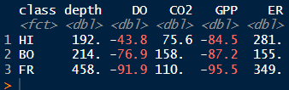
Results: Less-disturbed spring runs will have greater tolerance for flood events, experiencing less severe metabolic impacts (smaller magnitude of change, shorter duration, resistance to change, and linear recovery trajectories) as well as faster recovery times compared to more frequently flooded spring runs.
OS is the least impacted
Overall, metabolic productivity declined during floods and the degree of degradation increased with flood severity
ER Response Is Dome-Shaped… potentially due to river DOC flushing patterns?

Slide 15
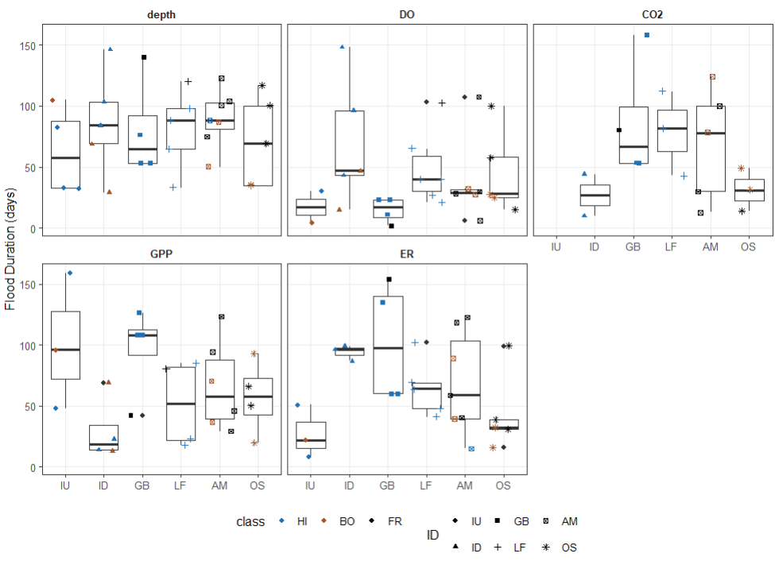
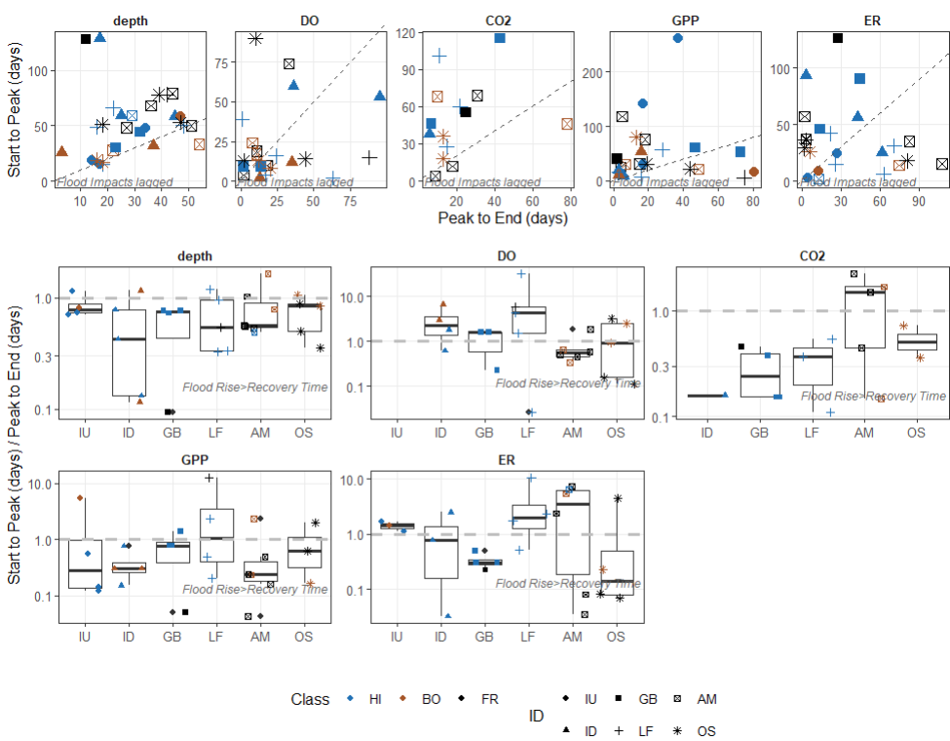
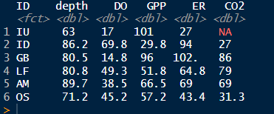
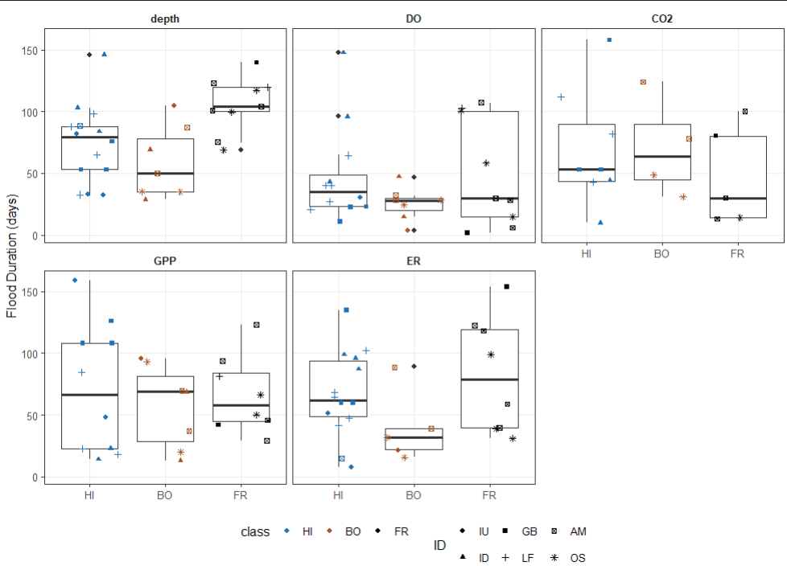

Results: Less-disturbed spring runs will have greater tolerance for flood events, experiencing less severe metabolic impacts (smaller magnitude of change, shorter duration, resistance to change, and linear recovery trajectories) as well as faster recovery times compared to more frequently flooded spring runs.
More vulnerable springs do not experience longer floods…
Overall, the rise of the flood lasted as long or longer than the recession of the flood.
OS had the shortest floods
But more severe floods have slightly longer lasting metabolic impacts…

Slide 16
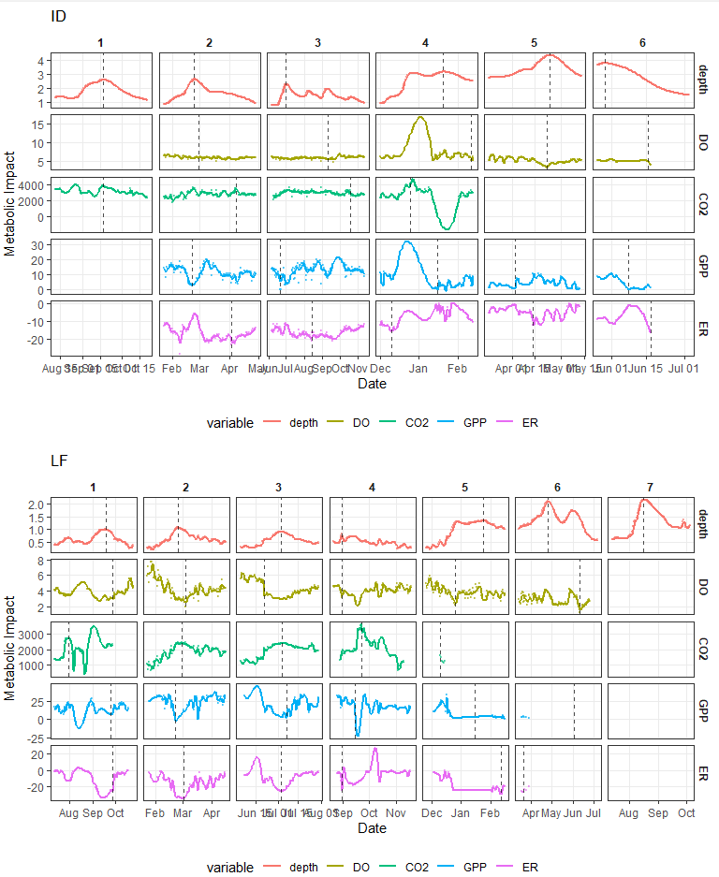
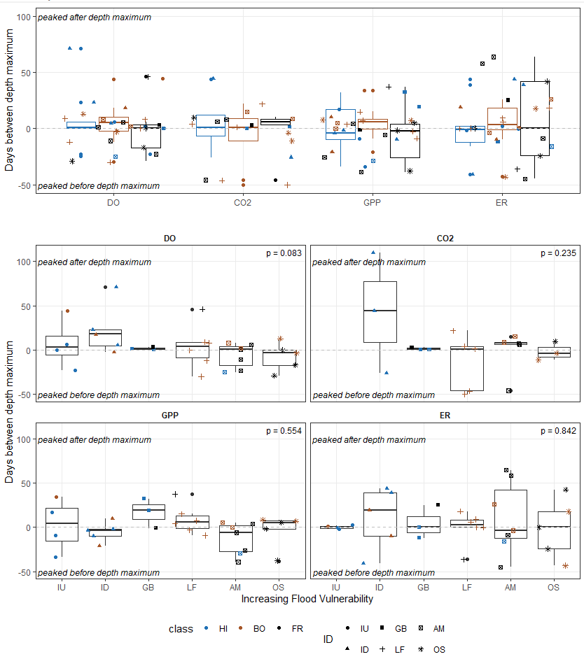
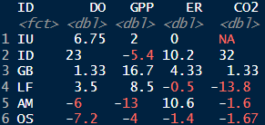
Results: Less-disturbed spring runs will have greater tolerance for flood events, experiencing less severe metabolic impacts (shorter duration, smaller magnitude of change, resistance to change, and linear recovery trajectories) as well as faster recovery times compared to more frequently flooded spring runs.
Resistance to Change: Delay in metabolic peaks:
Peak Delay Summary:
Generally, the metabolic signal peaks alongside depth

Slide 17
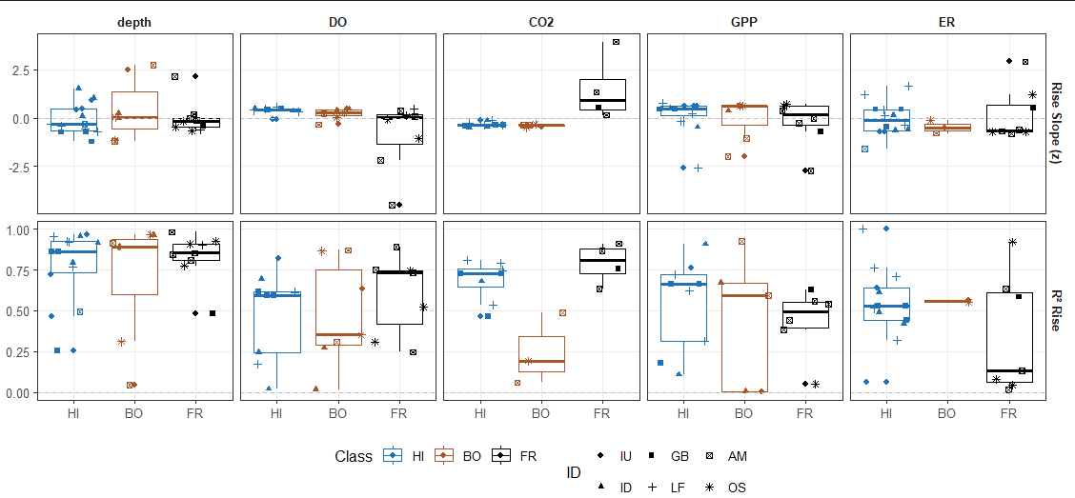
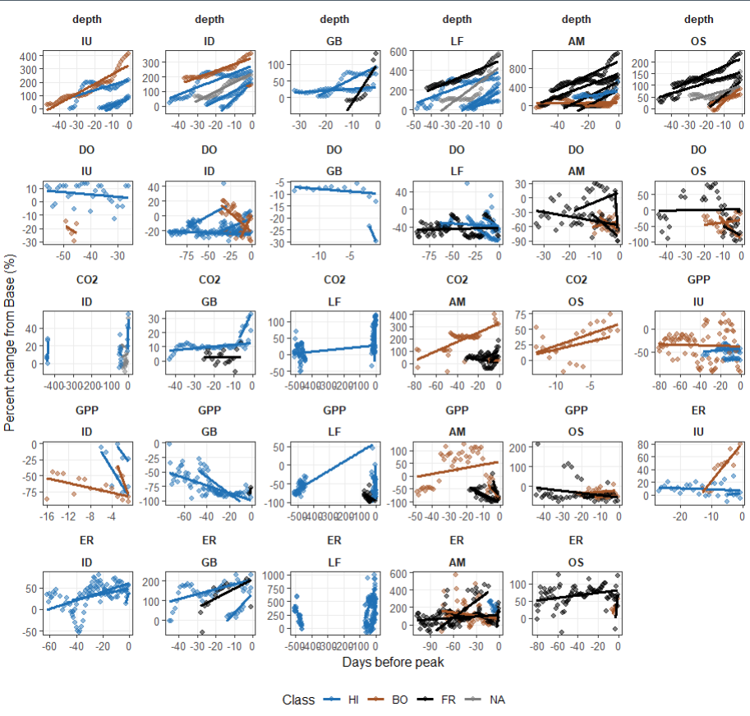
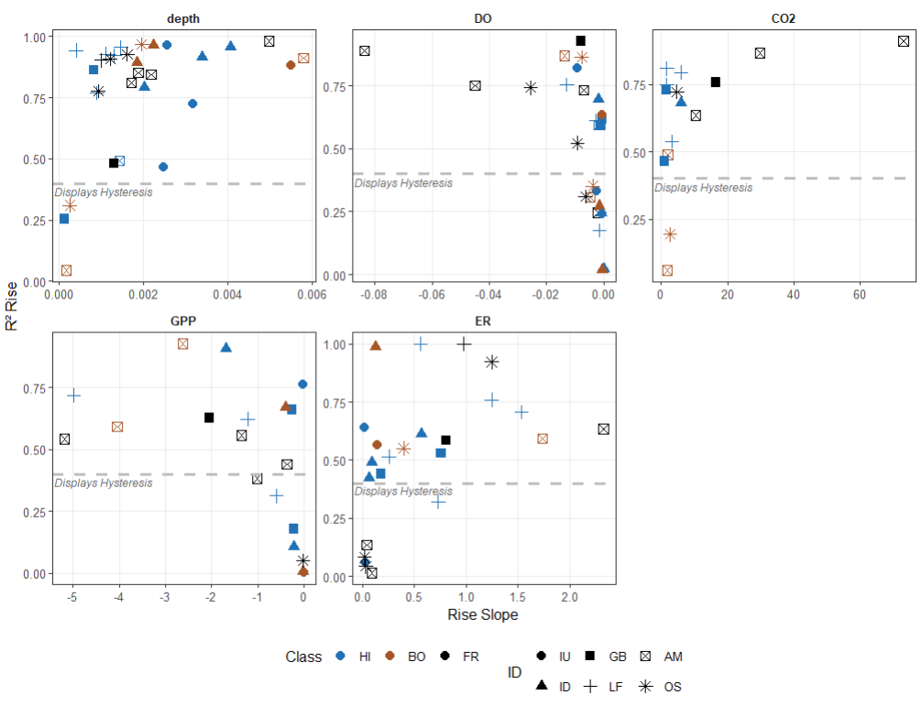
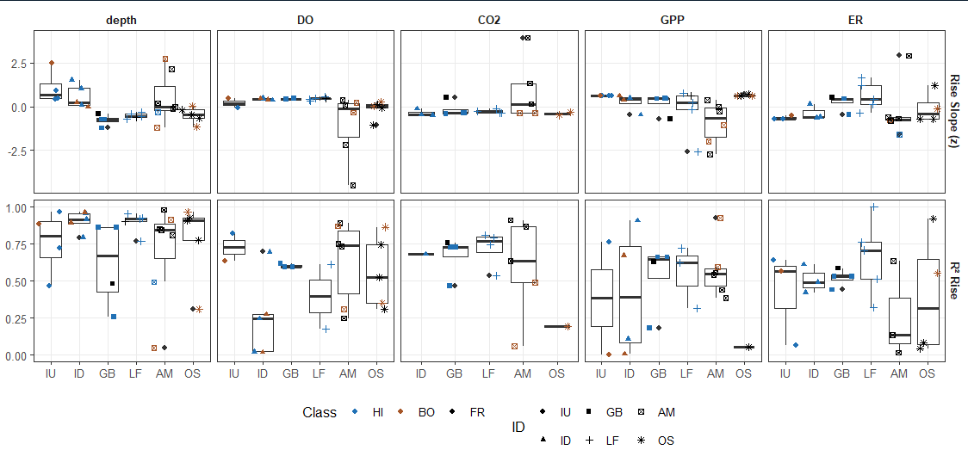
Results: Less-disturbed spring runs will have greater tolerance for flood events, experiencing less severe metabolic impacts (shorter duration, smaller magnitude of change, resistance to change, and linear recovery trajectories) as well as faster recovery times compared to more frequently flooded spring runs.
The rate of change largely did not differ with flood severity. ER had the lowest R^2
Resistance to Change: Trajectory of Metabolic Impacts
Vulnerable springs reacted to uniquely to flood disturbances compared to less vulnerable springs with the most obvious changes appearing in GPP and ER.

Slide 18
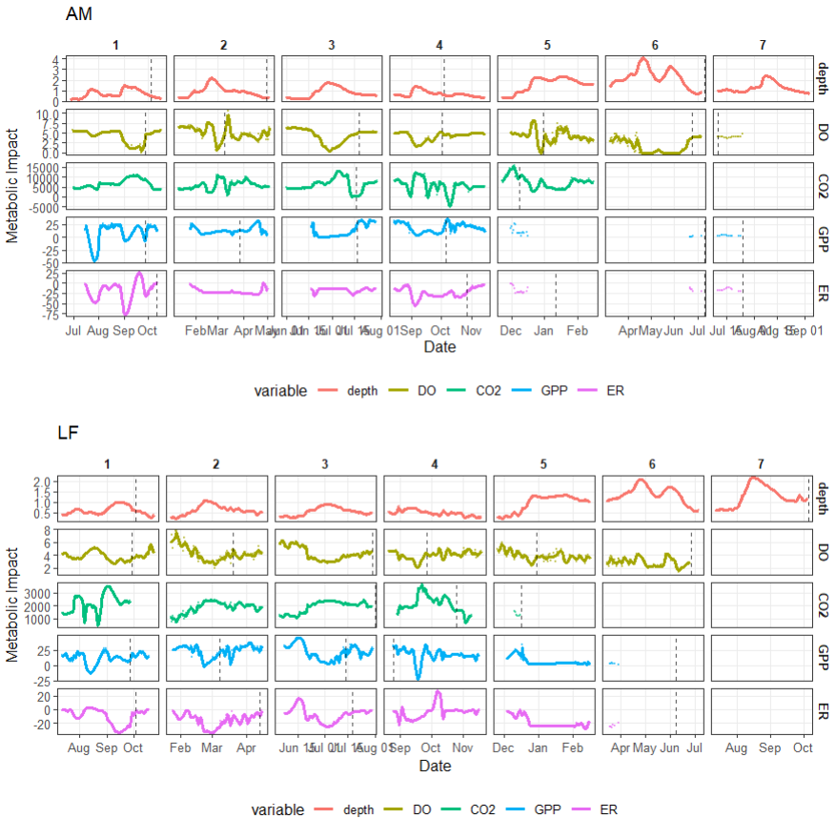
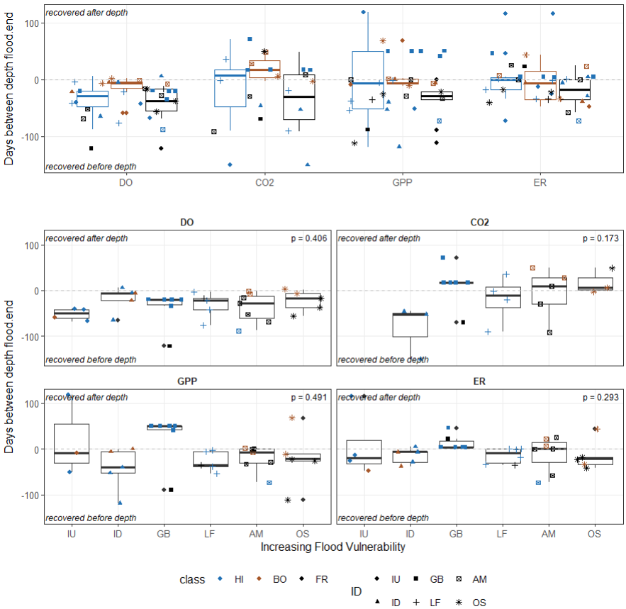
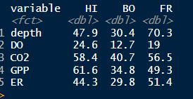
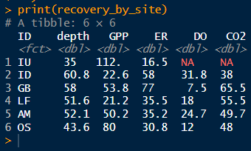
Results: Less-disturbed spring runs will have greater tolerance for flood events, experiencing less severe metabolic impacts (shorter duration, smaller magnitude of change, resistance to change, faster recoveries, and linear recovery trajectories) as well as faster recovery times compared to more frequently flooded spring runs.
End of Flood:
On average, metabolic variables returned to baseline alongside or shortly after depth
HI and IU+ ID have the longest recoveries but experience minimal metabolic impacts. This may be an artifact of how I have isolated flood events (slide 6) and may benefits from including an additional depth criteria.
Generally, both vulnerable and less vulnerable springs returned to baseline in the same amount of time with no obvious pattern.

Slide 19
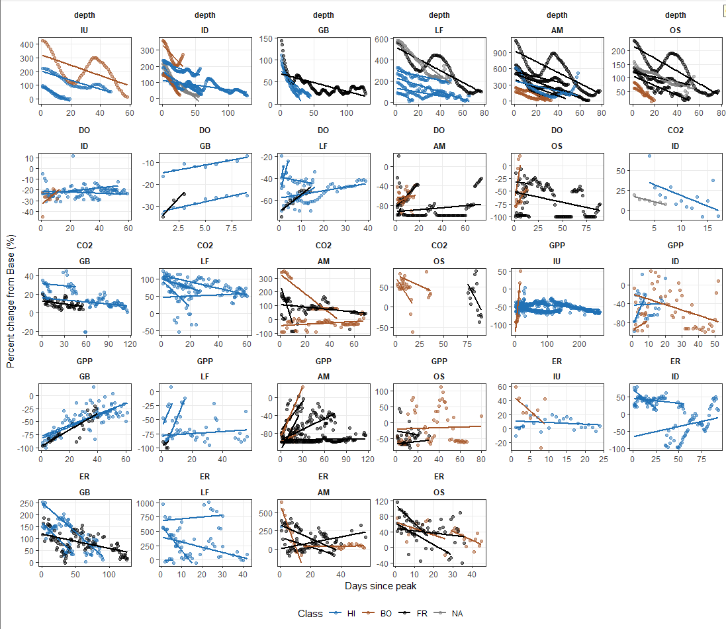
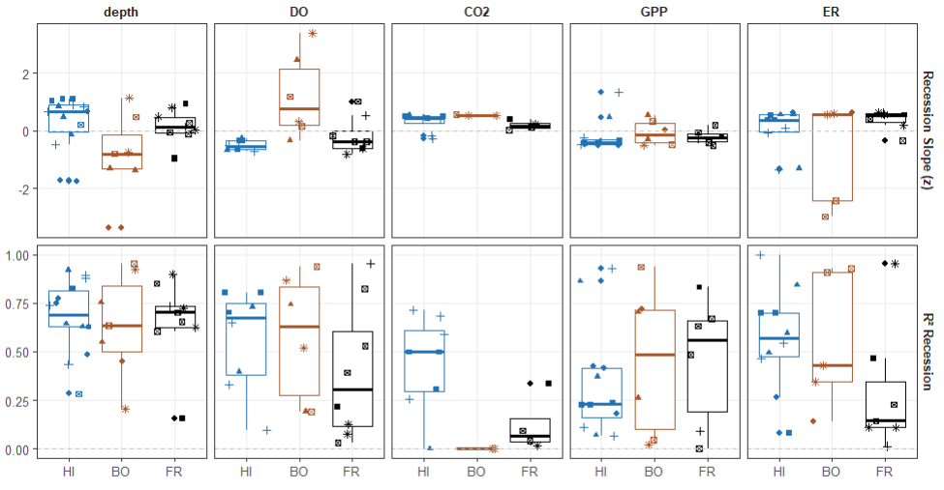
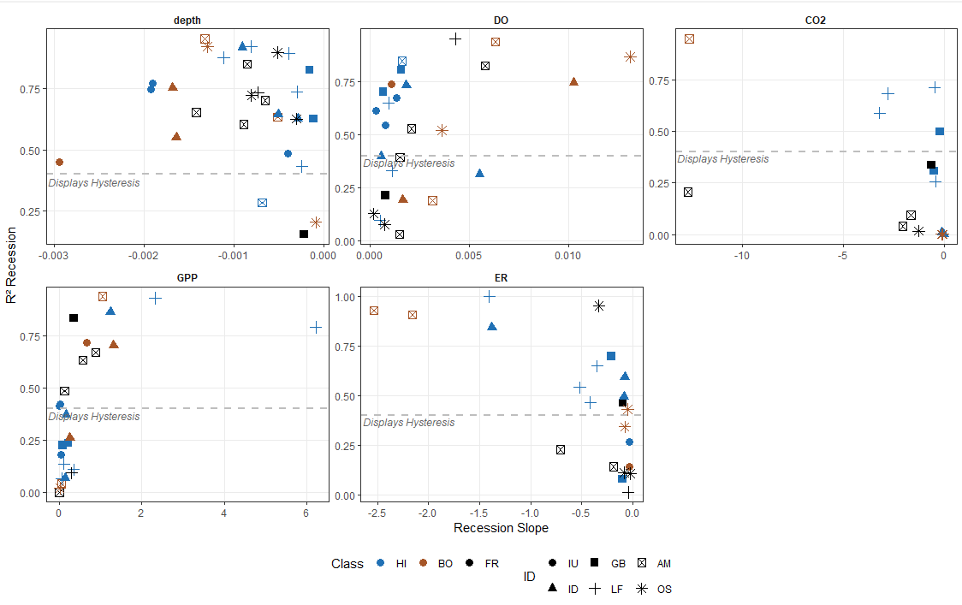
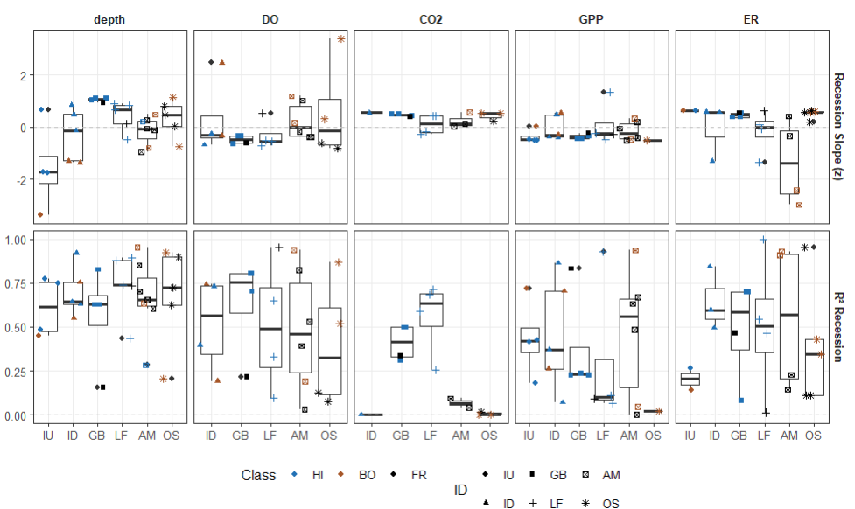
Results: Less-disturbed spring runs will have greater tolerance for flood events, experiencing less severe metabolic impacts (shorter duration, smaller magnitude of change, resistance to change, faster recoveries, and linear recovery trajectories) as well as faster recovery times compared to more frequently flooded spring runs.
Again, rate of recovery across floods is similar . R2 increases with increasing flood severity.
At high-vulnerability sites (AM, OS), the recovery path is irregular and poorly described by a linear model. Vulnerable springs may have bgc/micro-communitues of spring and river environments producing a noisier recession signal. The more spring-like the site, the more stereotyped the recovery.

Slide 20
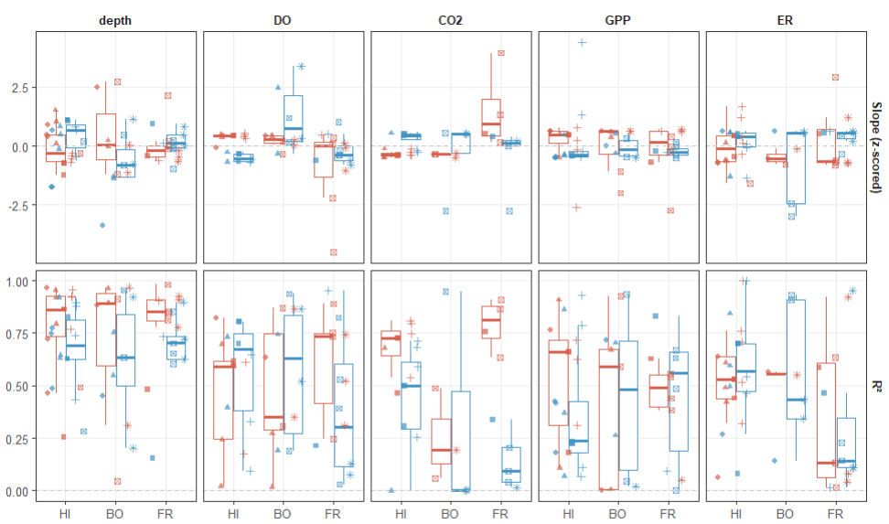
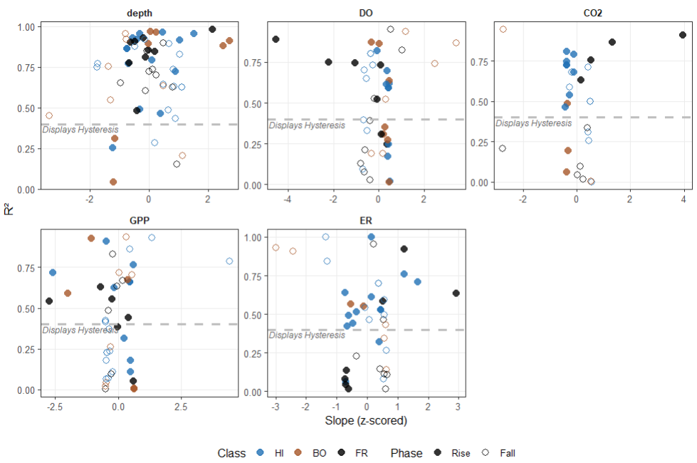
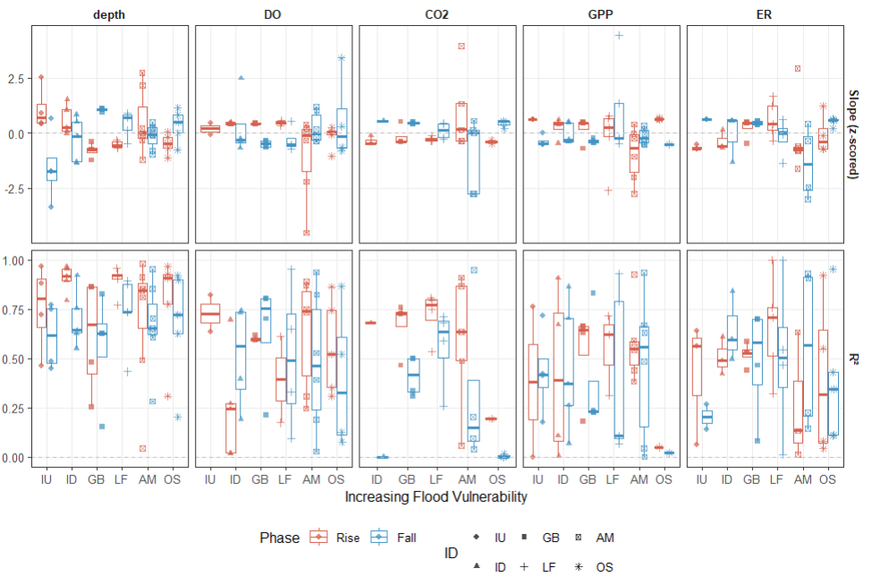
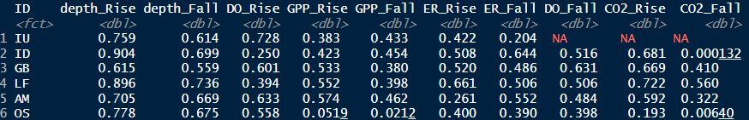
Results: Comparing the trajectories for the rise and fall of flood events
DO and CO₂ rise more linearly than they recover; ER and GPP ₂ recover more linearly than they rise
DO and CO₂ are impacted by the incoming flood water in a physically-driven way
The magnitude of the ER and GPP impacts depends on how much DOC was delivered, which can differ by flood type and flood size
GPP recovers more linearly consistent with autotrophs recovering along a consistent with autotroph recoverin along light/flow-driven trajectory.
ER recovery may be more linear because microbial decomposition is a relatively predictable rate

Slide 21
Key Takeaways:
North Florida spring metabolism is driven by source water, and in turn, light availability. Flood disturbances represent the primary mechanism by which source water shifts from light and DOC-depleted to dark and DOC-rich.
A tight mechanistic cascade follows from source water shifts: Stage ↑ → light attenuation ↑ → GPP ↓ → DO ↓ + CO₂ ↑
The most vulnerable spring (OS) has the lowest net ecosystem production yet shows comparatively moderate metabolic responses to individual flood events. This suggests that chronically reversing springs may have entrained river-derived DOC and microbial communities into their baseline state, reducing the incremental metabolic impact of any single disturbance.
BO and FR floods produce broadly similar metabolic impacts for GPP and DO, suggesting that light occlusion and labile carbon introduction are the primary metabolic drivers, rather than a complete shift in source water.
Spring metabolism recovers on timescales comparable to, or shorter than, physical stage recovery, though with considerable variability in the trajectory of that recovery.
At high-vulnerability sites (AM, OS), the post-flood recovery path is irregular and poorly described by a linear model. This may reflect mixed biogeochemical and microbial communities that create a hybrid spring-river environment, producing a noisier and less predictable recession signal.
The more spring-like the site, the more stereotyped and predictable the recovery trajectory.
DO and CO₂ are more consistent indicators of the physical flood signal. Their response to incoming flood water is linearly and predictably related to stage. GPP and ER capture the biological consequences of flooding, which are more variable across sites and flood types. Both sets of variables are necessary for a complete picture, but they address different aspects of the disturbance.
The most frequently reversing springs experienced comparatively moderate metabolic impacts from individual flood events, consistent with chronic disturbance shifting the baseline metabolic state toward a mixed spring-river community.
DO and CO₂ are more predictably impacted by the physical arrival of flood water (more linear rise signal), but their recovery is noisier due to the interacting biological processes that govern return to baseline.
GPP recovery is relatively linear, consistent with autotrophs tracking the return of stable light and flow conditions. ER recovery is similarly linear because microbial decomposition of river OM proceeds at a relatively predictable rate once flood conditions stabilize

